Slide 1
Welcome to Rocket Phonics

Slide 2
What is Rocket Phonics?
A fully resourced, systematic synthetic phonics programme that provides you with everything you need to teach children to read and write.
It provides a combination of digital and printed resources, and a fully matched series of decodable reading books.

Slide 3
What makes Rocket Phonics unique?
2. Mapped out structure
3. Straightforward clarity
4. Engaging aesthetics
1. Steady pace

Slide 4
What resources does Rocket Phonics have?
2. Print resources: flashcards, pupil practice booklets, reading books
1. Online platform: everything

Slide 6
What ‘stuff’ do we get?
Digital Big Books

Slide 7
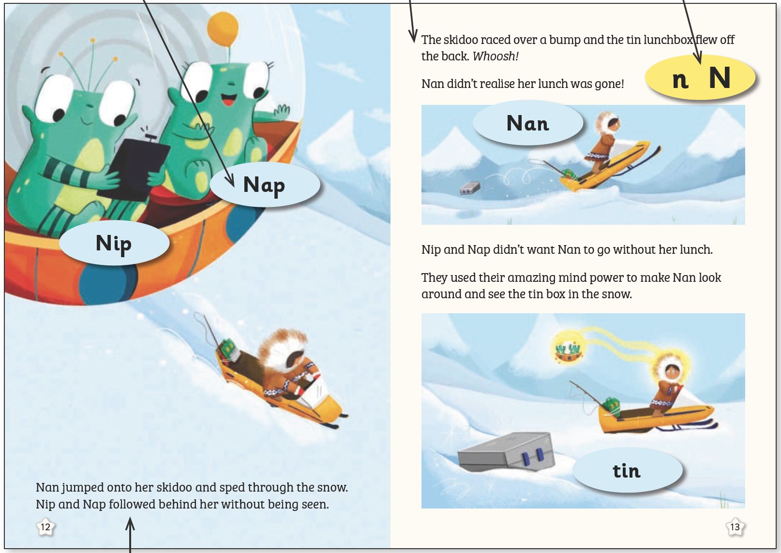
At the heart of the programme are the digital-only ‘Big Books’, which consist of language rich stories to teach all the target letter-sounds in context.
1
2
3
4

Slide 8
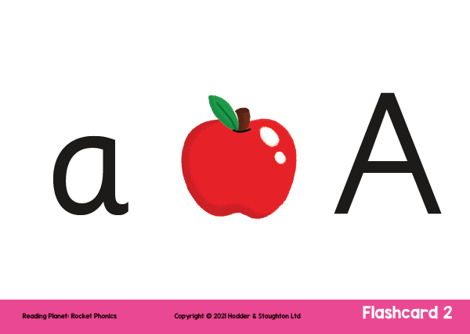
What ‘stuff’ do we get?
Flashcards

Slide 9
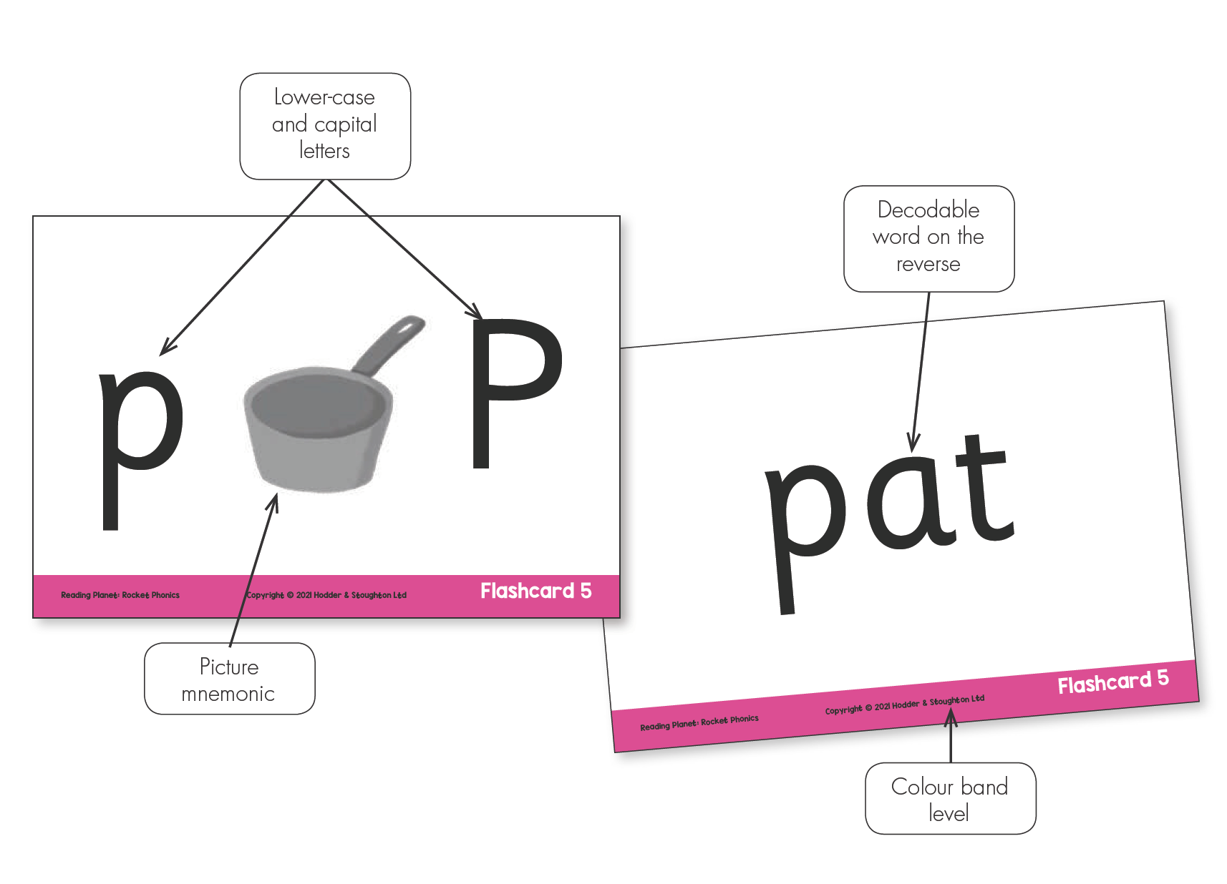
Flashcards are designed for reviewing previously taught letter-sounds as well as introducing new letter-sounds.

Slide 10
The digital versions can be launched from the Big Books and include audio of the letter-sounds and example words.

Slide 11
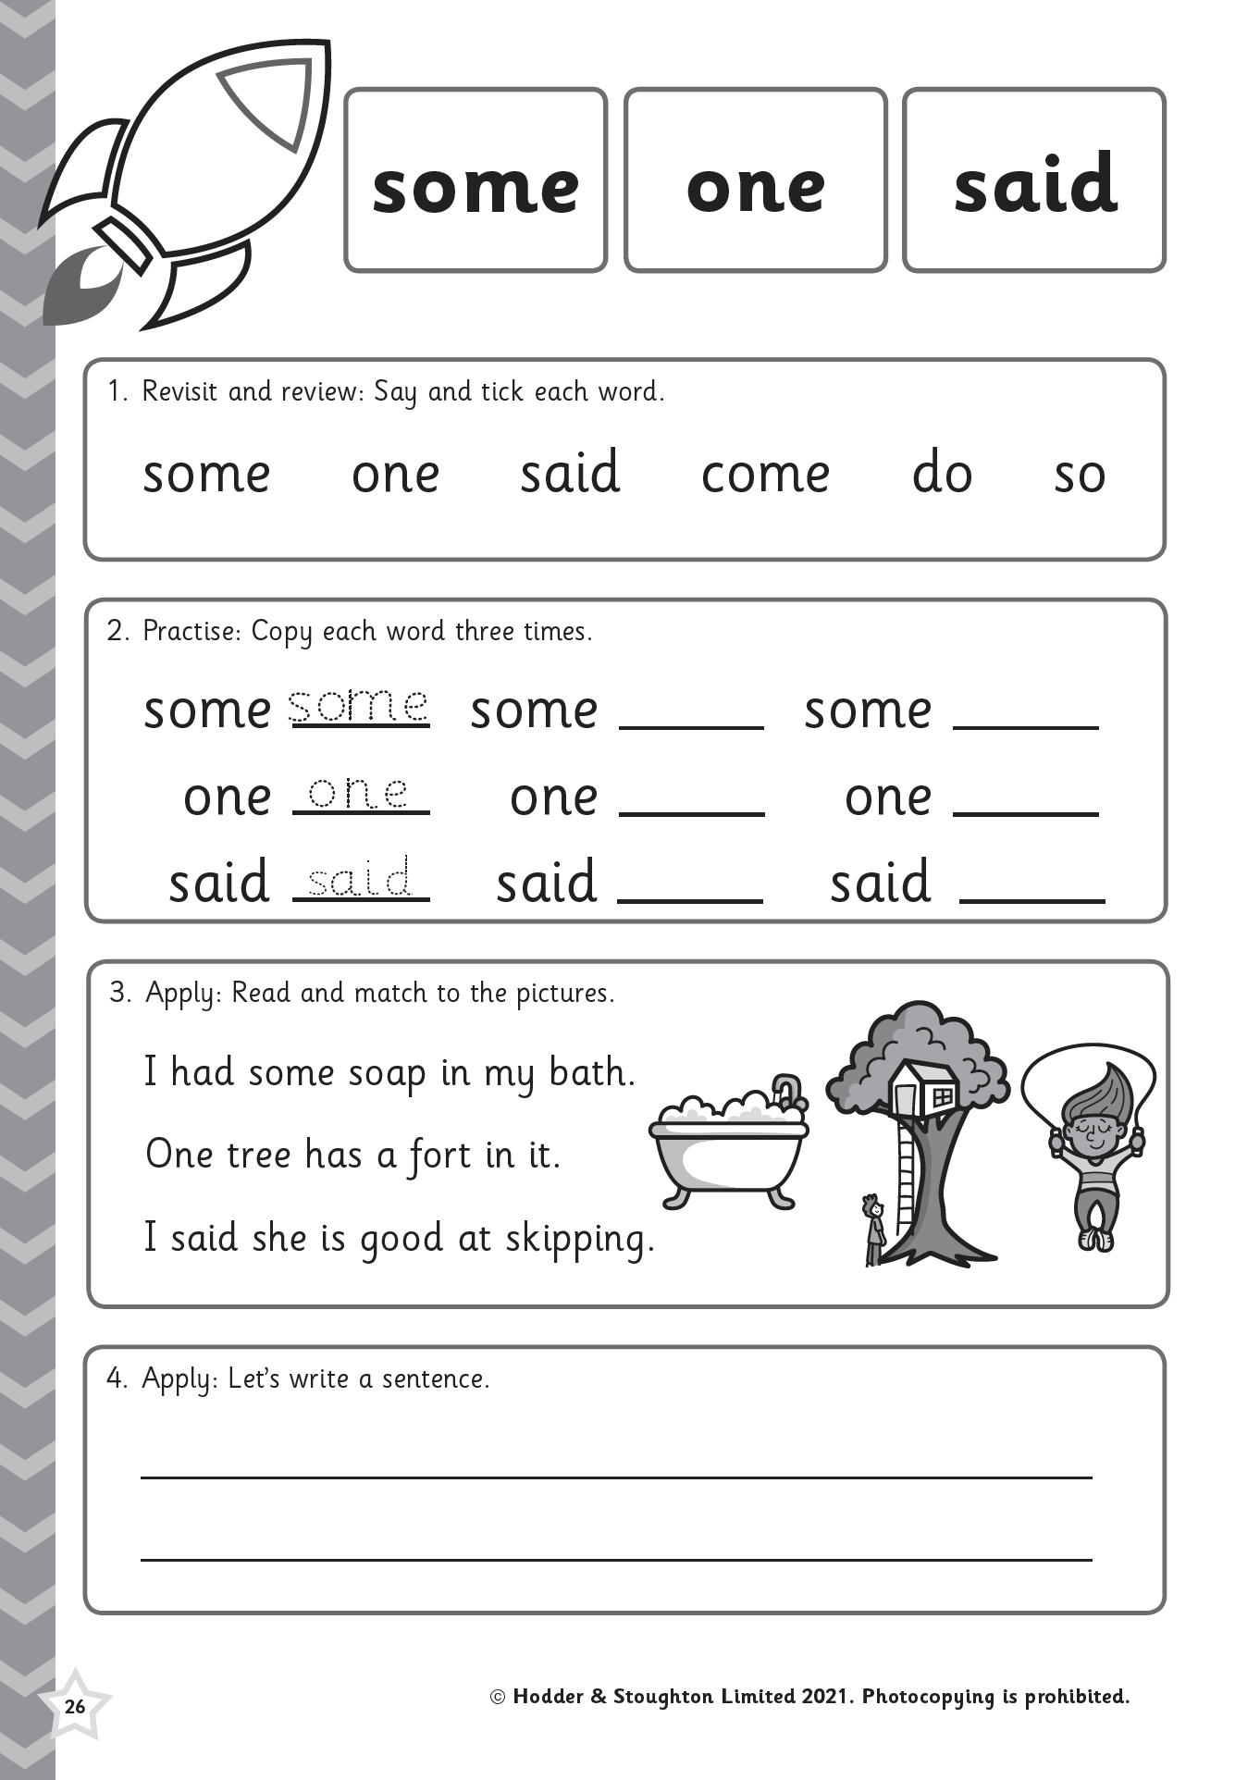
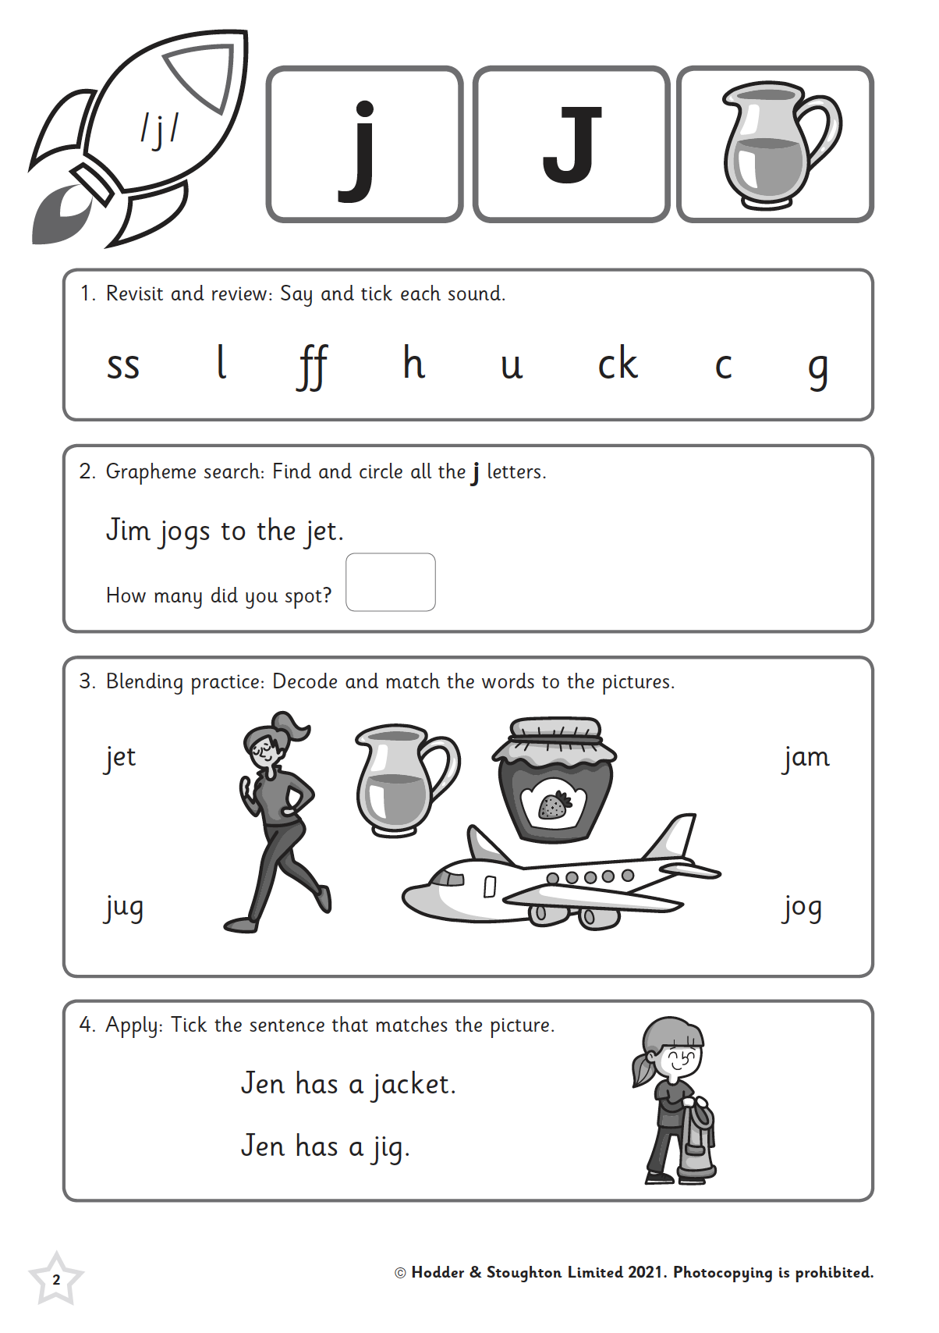
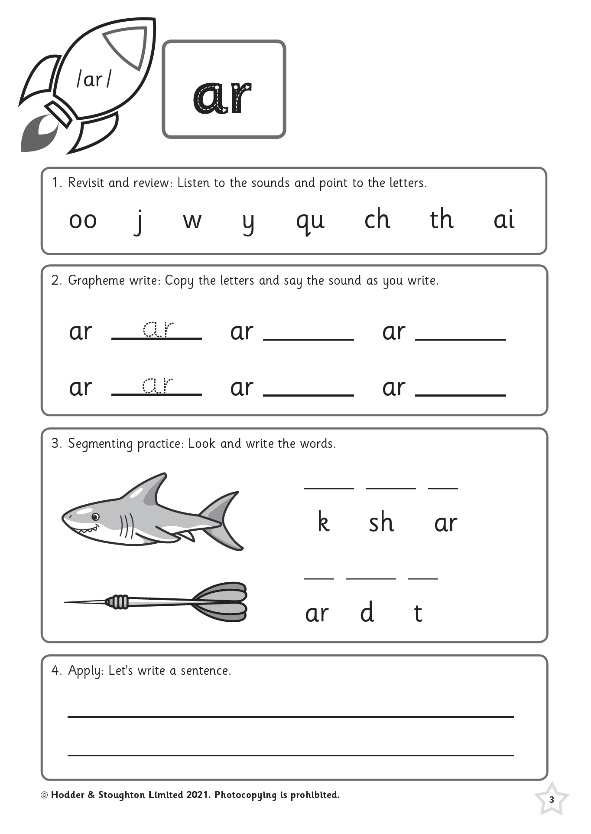
What ‘stuff’ do we get?
Pupil Practice Booklets

Slide 12
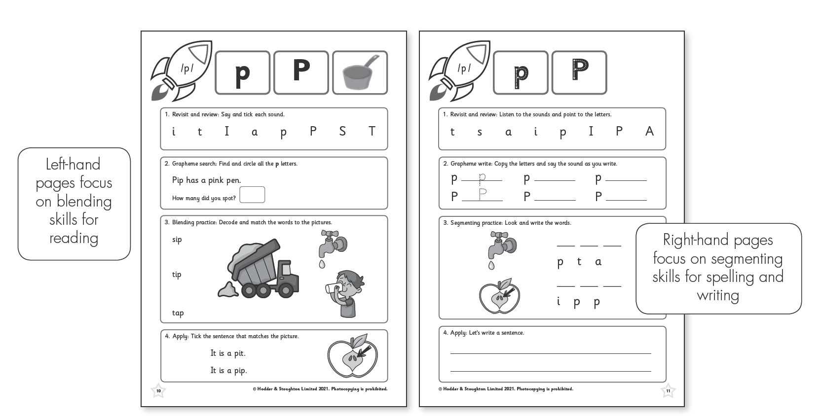
The Pupil Practice Booklets enable children to practise and apply blending and segmenting skills at letter-sound, word, sentence and text levels.

Slide 13
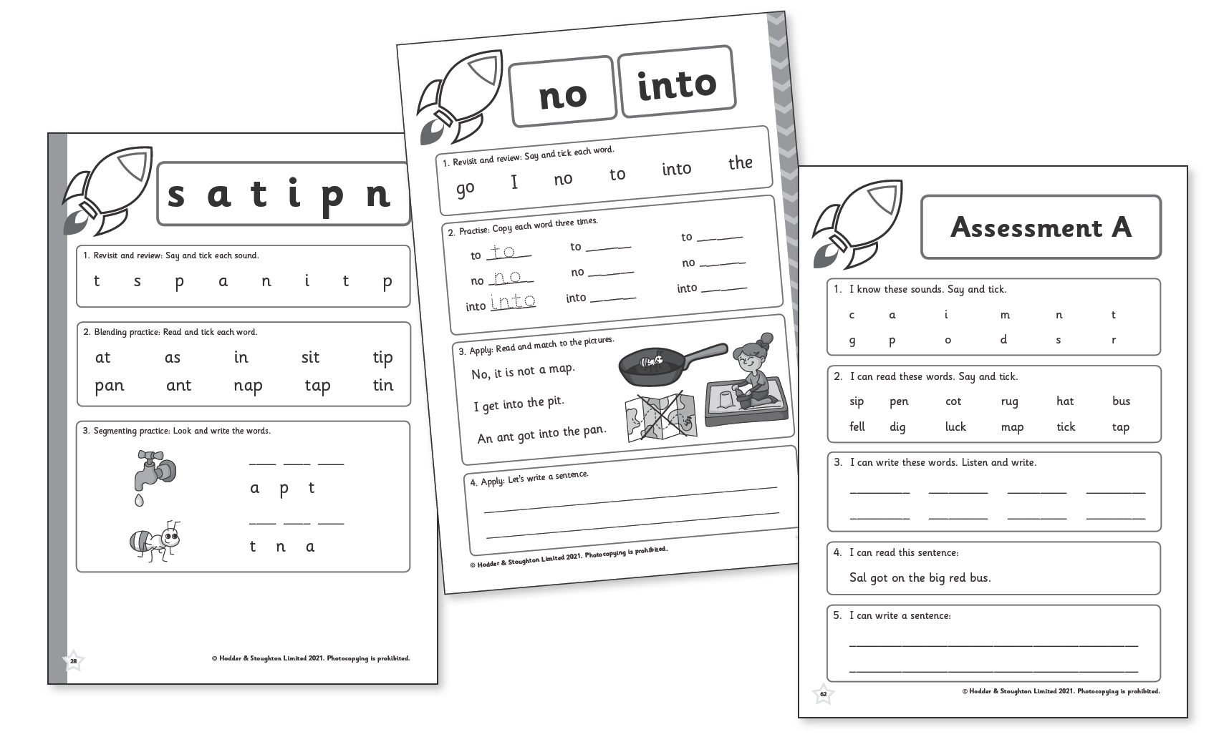
There are also review and common exception word pages, and two mini-assessments at the end of each booklet.

Slide 14
What ‘stuff’ do we get?
Sounds
Mats

Slide 15
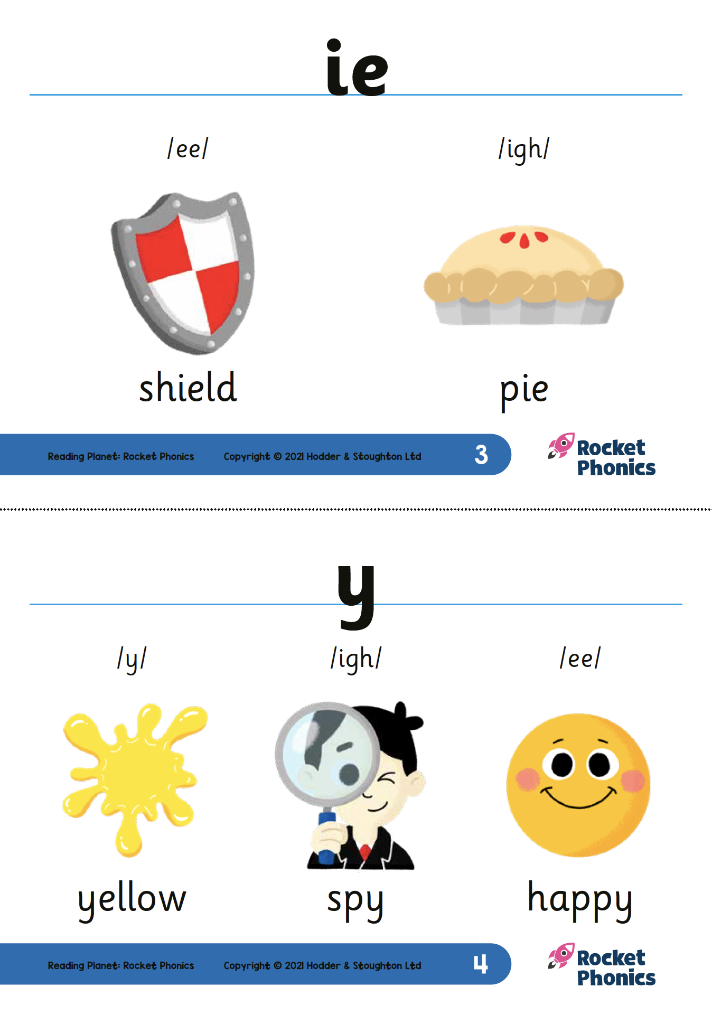
What ‘stuff’ do we get?
Frieze

Slide 16
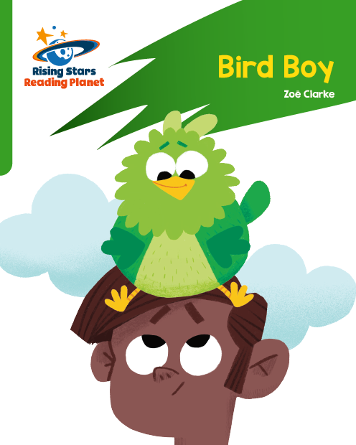
What ‘stuff’ do we get?
Target Practice Readers

Slide 17
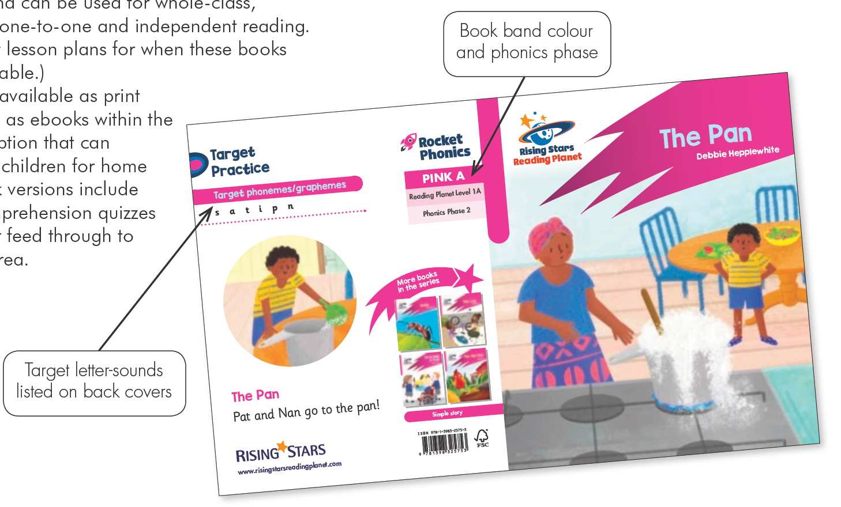
Target Practice reading books provide focused practice of small groups of target letter-sounds. The books are fully decodable and can be use for whole-class, group guided, 1:1 and independent reading.

Slide 18
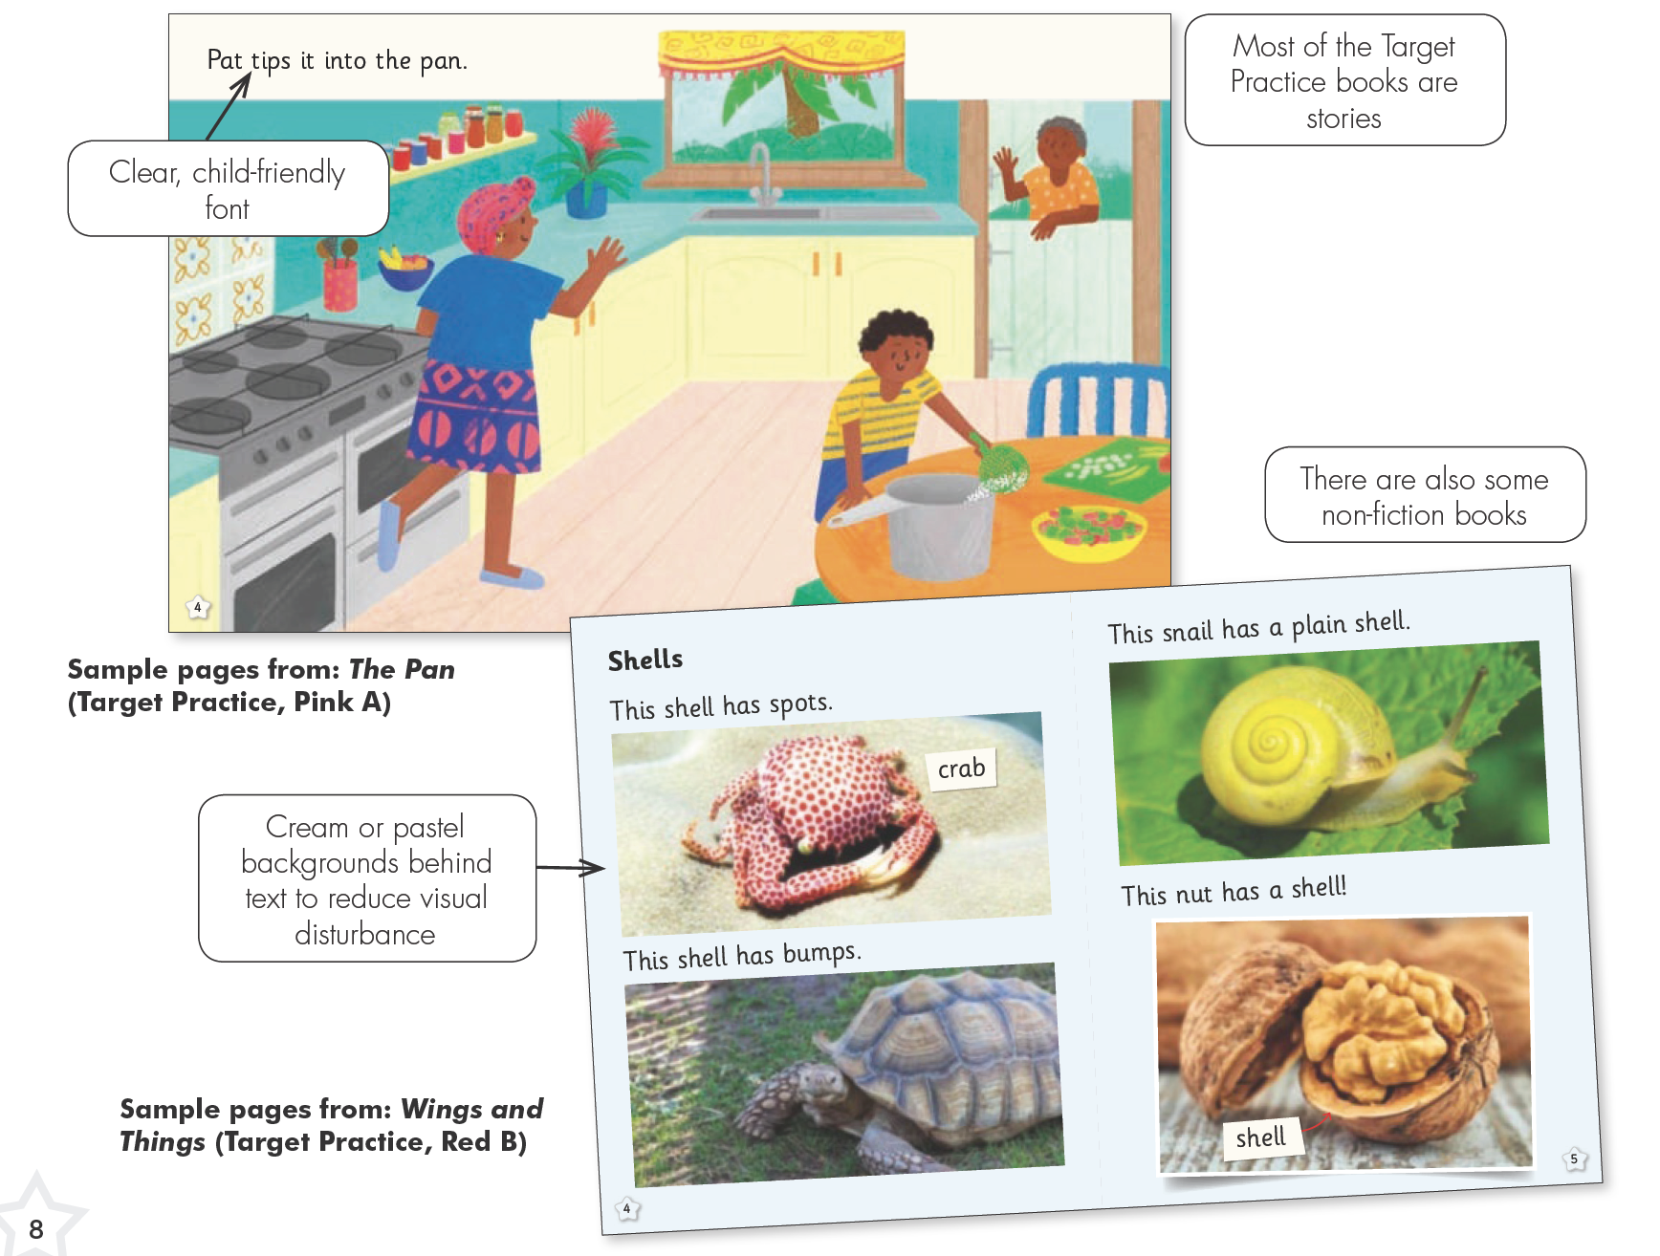
The books are available as print editions as well as ebooks within the Online Subscription that can be assigned to children for home use. The ebook versions include audio and comprehension quizzes.

Slide 19
What ‘stuff’ do we get?
Frieze
Rocket Phonics Reading Books

Slide 20
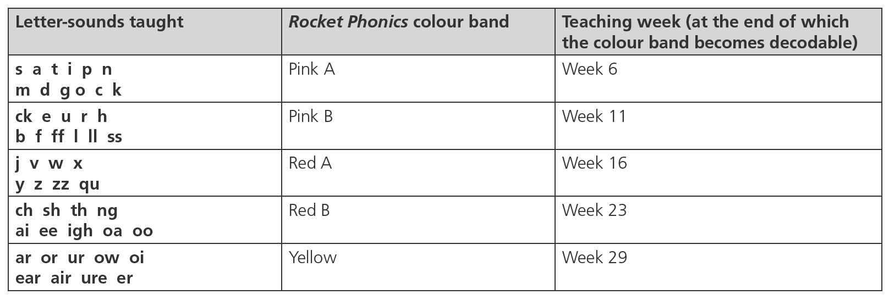
The Rocket Phonics reading books are the ideal as additional decodable reading practice books. These books are fully aligned and can be used as soon as all the letter-sounds in a particular colour band have been taught.

Slide 21
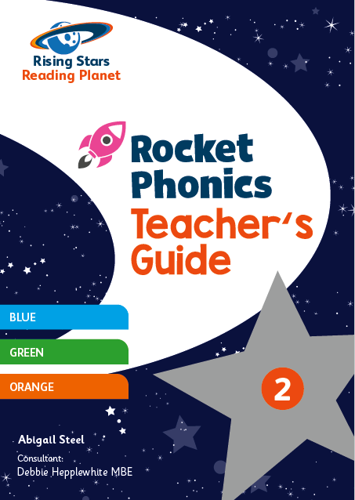
What ‘stuff’ do we get?
Teacher Guides

Slide 22
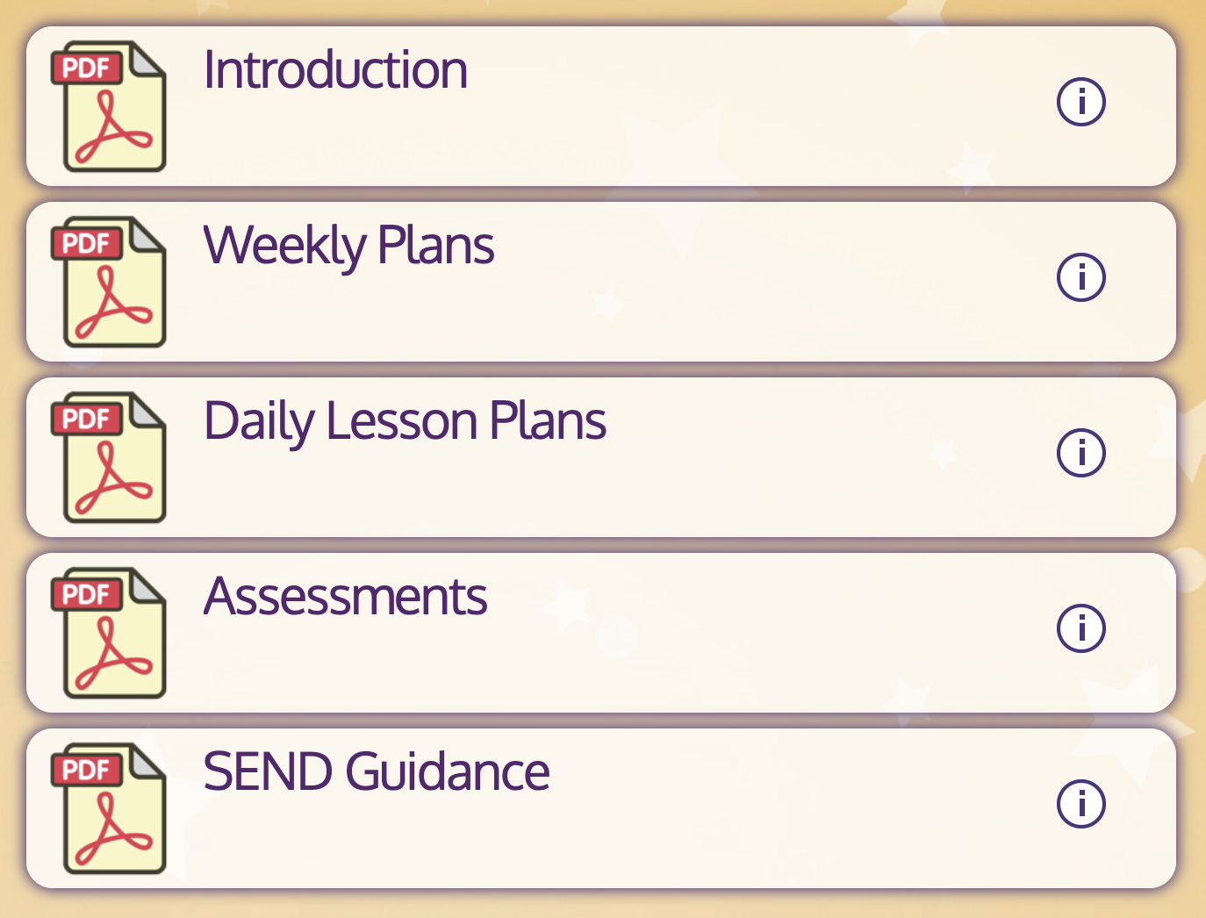
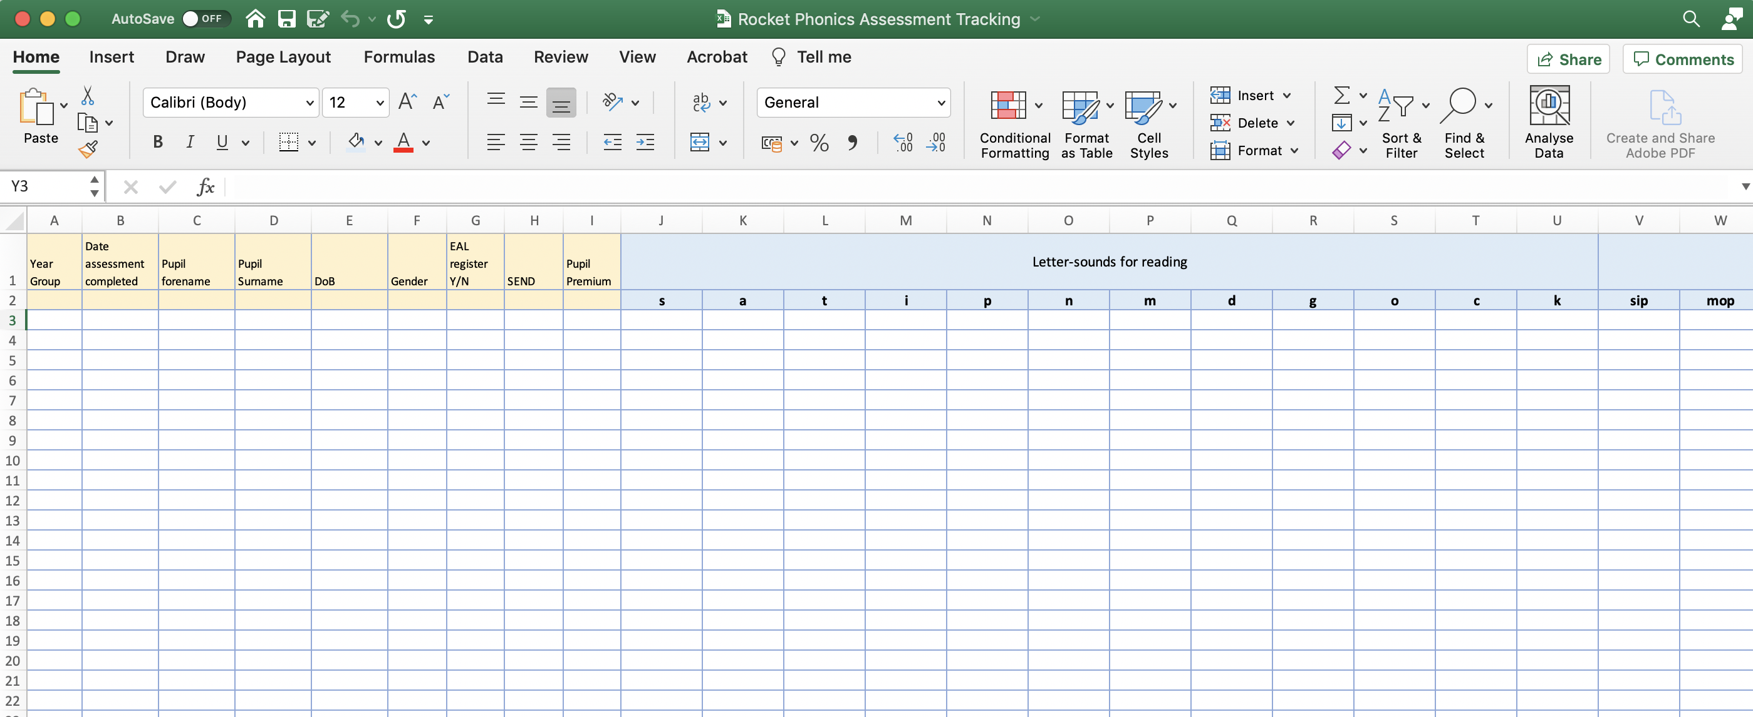
The programme also includes a full suite of assessments, including a Baseline assessment and half-termly tests. These are available to download and print.

Slide 23
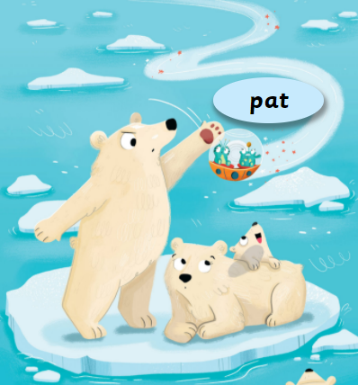
Pace & Progression

Slide 24
Slow and steady wins the race
2 letter-sounds per week
Consistency
Reception = 60 letter-sounds
Year 1 = 70 letter-sounds

Slide 25
How does it compare with L&S (2007)?
 | Letters & Sounds (2007) | Rocket Phonics
Reception Term One | Phase 2 | Phase 2
Reception Term Two | Phase 3 | Phase 3/4
Reception Term Three | Phase 4 | Phase 3/4/5
Year One | Phase 5 | Phase 5

Slide 26
Weekly structure
Monday: new letter-sound with a blending focus
Tuesday: repeat letter-sound with a segmenting focus
Wednesday: new letter-sound with a blending focus
Thursday: repeat letter-sound with a segmenting focus
Friday: Common exception words (CEWs/tricky words), consolidation, assessment, enrichment

Slide 27
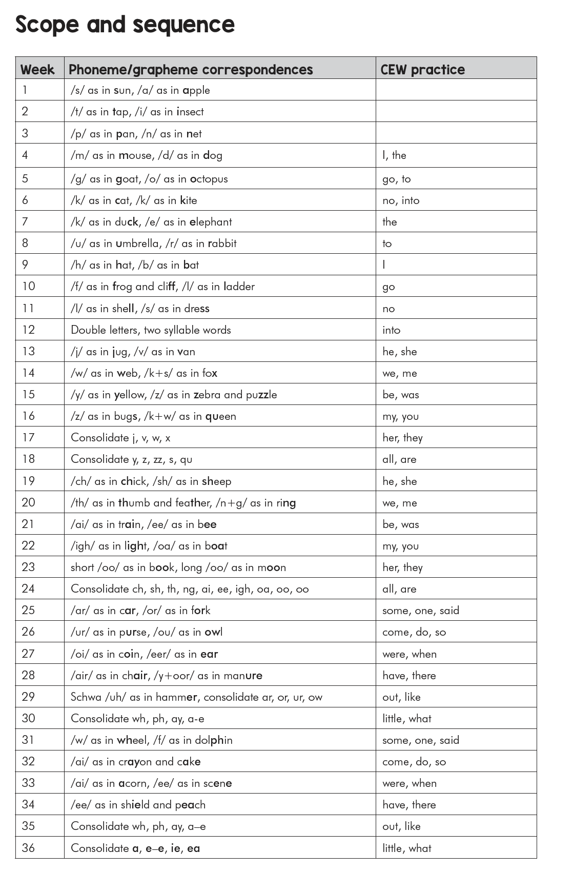
Teacher Guide: Scope and sequence

Slide 28
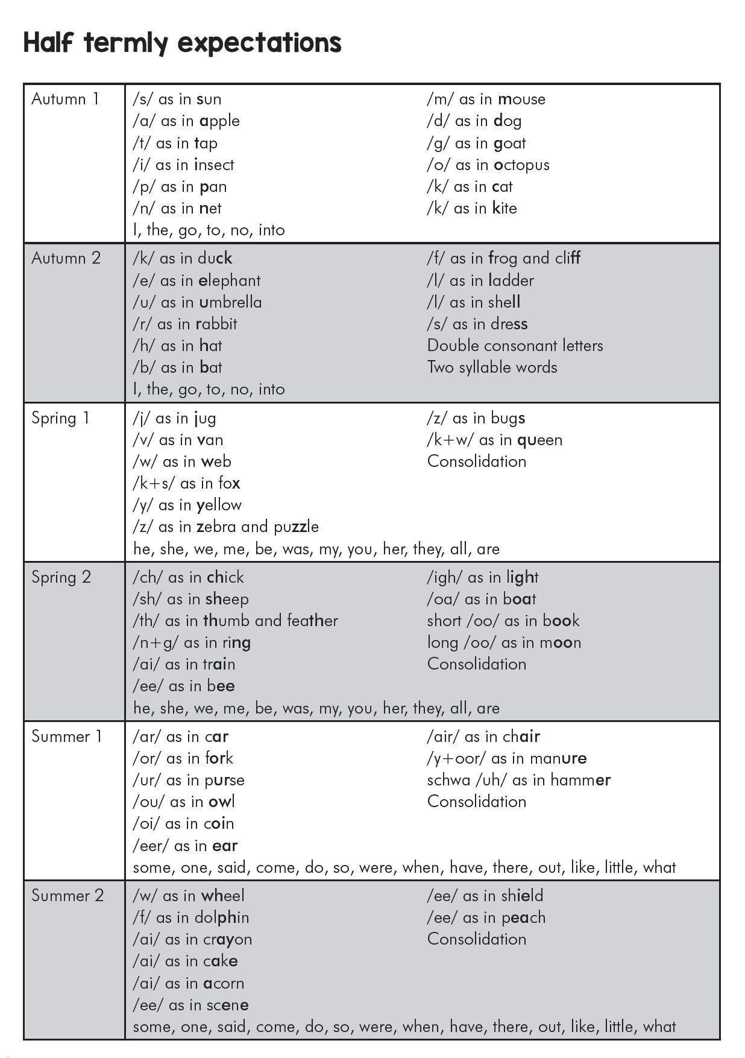
Teacher Guide: Expectations

Slide 29
Reception Autumn half-term 1
s a t i p n m d g o c k
cvc words
I the go to no into

Slide 30
Reception Autumn half-term 2
ck e u r h b f ff l ll ss
cvc, cvccvc words
I the go to no into
words with double letters

Slide 31
Reception Spring half-term 1
j v w x y z zz qu
cvcc, ccvc words (e.g. jump, spin)
words ending s as /z/ (e.g. bags)
he she we me be was my you her they all are

Slide 32
Reception Spring half-term 2
ch sh th ng ai ee igh oa oo oo
he she we me be was my you her they all are

Slide 33
Reception Summer half-term 1
ar or ur ow oi ear air ure er
some one said come do so were when have there out like little what

Slide 34
Reception Summer half-term 2
wh ph
/ai/ ay a-e a
/ee/ e-e ie ea
some one said come do so were when have there out like little what

Slide 35
Year 1 Autumn half-term 1
/igh/ i i-e ie y
/oa/ o-e ow oe o
/ee/ y ey
some one said come do so were when have there out like little what

Slide 36
Year 1 Autumn half-term 2
/y+oo/ u u-e ue ew
long /oo/ u u-e ue ew
/ur/ er ir
ou oy
oh their people Mr Mrs looked called asked could water where

Slide 37
Year 1 Spring half-term 1
/or/ au aw al our ore oor augh
/oa/ ou long /oo/ ou
/ar/ a al /ur/ ear or
/eer/ eer ere /air/ are ear ere
who again thought through many laughed because any eyes friends once please

Slide 38
Year 1 Spring half-term 2
/s/ c se ce /j/ g dge ge
/e/ ea /uh/ o
/k/ ch /sh/ ch
oh their people Mr Mrs looked called asked could water where

Slide 39
Year 1 Summer half-term 1
le ed ed mb kn gn wr tch
/zh/ s si ge
oh their people Mr Mrs looked called asked could water where

Slide 40
Year 1 Summer half-term 2
/ch+u/ ture /i/ y
/s/ sc st /o/ a
/sh/ ti ci ssi
who again thought through many laughed because any eyes friends once please

Slide 41
Starting mid-programme?
Map against a calendar
Don’t be afraid to have a longer-term plan
Start Year 1 on Reception Summer half-term 2
Know your children

Slide 42
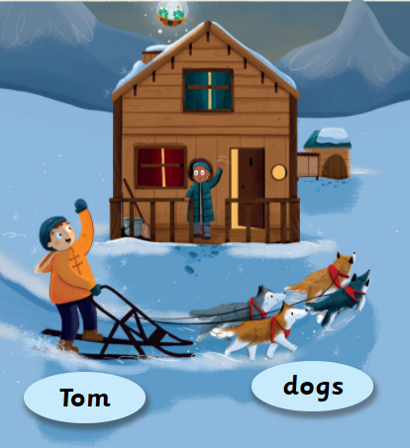
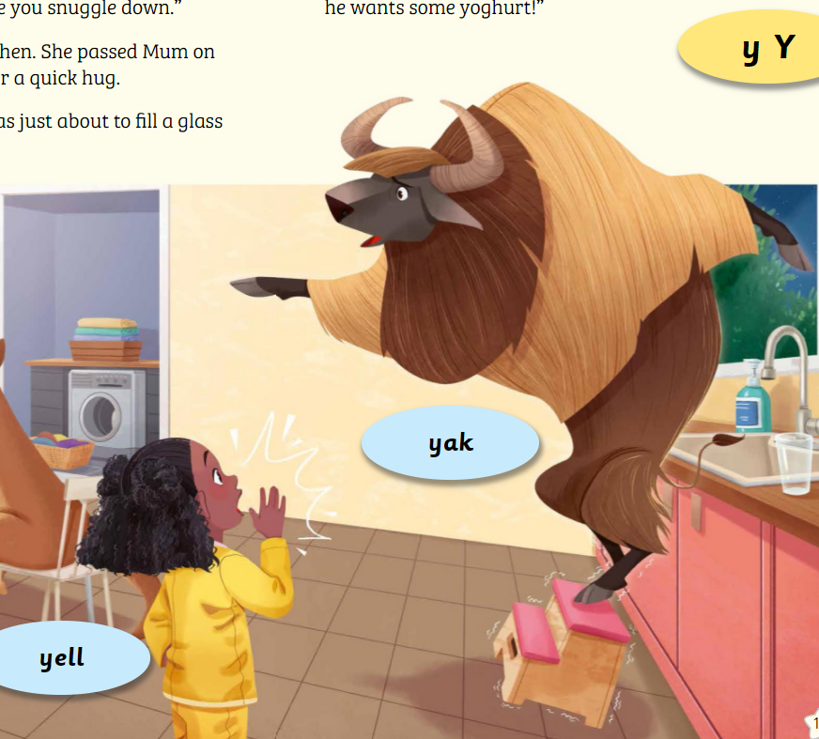
Lesson Structure & The Teaching and Learning Cycle

Slide 43
What is the Teaching and Learning Cycle?
Revisit and review
Teach
Practise
Apply
Assess/ consolidate

Slide 44
The Systematic Synthetic Phonics Teaching Principles
Knowledge of the alphabetic code
Skill of blending
Skill of segmenting
Skill of handwriting

Slide 45
The challenge
Knowledge of the alphabetic code
Skill of blending
Skill of segmenting
Skill of handwriting
at code level (letter-sounds) (with reversibility)
at word level (with vocabulary)
at sentence level (with fluency)
at text level (with comprehension)

Slide 46
The Rocket Phonics Solution
Revisit and review
Teach
Practise
Apply
Revisit and review
Teach
Practise
Apply
BLENDING FOCUS
SEGMENTING FOCUS

Slide 47
Weekly structure
Monday: new letter-sound with a blending focus
Tuesday: repeat letter-sound with a segmenting focus
Wednesday: new letter-sound with a blending focus
Thursday: repeat letter-sound with a segmenting focus
Friday: Common exception words (CEWs/tricky words), consolidation, assessment, enrichment

Slide 48
Blending Day
Flashcards
Revisit and review
Teach
Practise
Apply
Target Practice Reading Book
BLENDING FOCUS
Big Book
story spread
Pupil Practice Booklet

Slide 49
Segmenting Day
Air-writing
Revisit and review
Teach
Practise
Apply
Wider curriculum
SEGMENTING FOCUS
Flipchart modelling
Pupil Practice Booklet

Slide 50
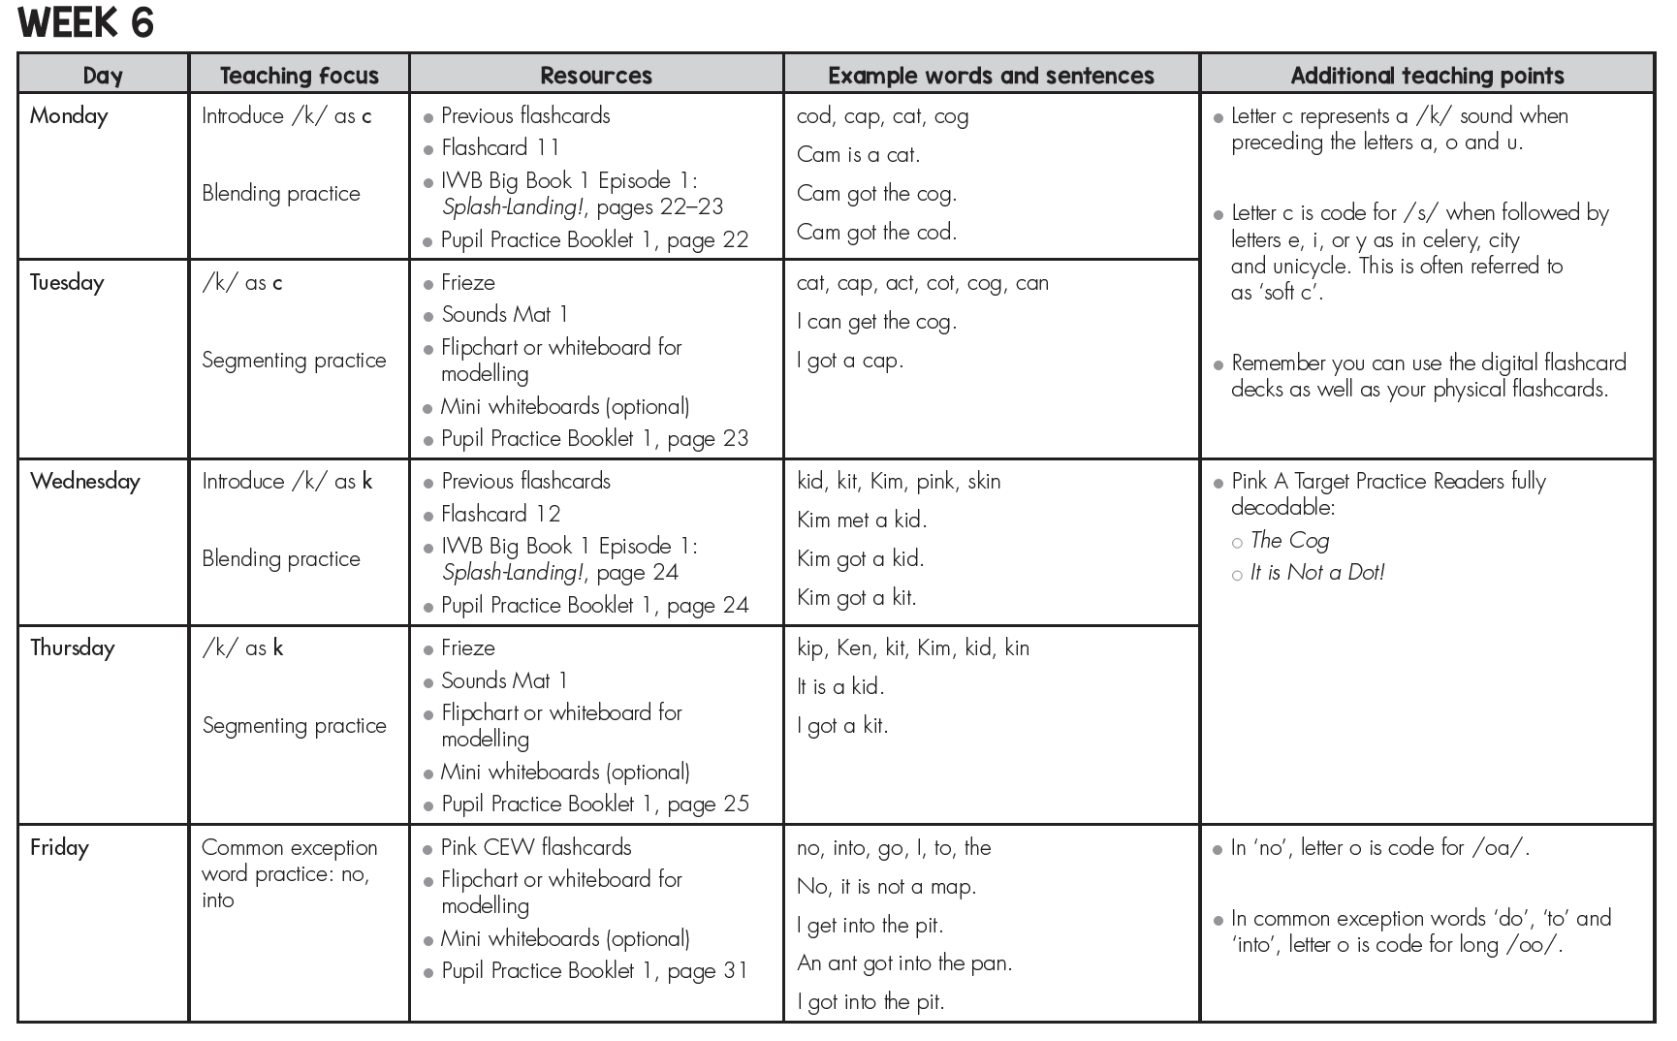
Weekly plans

Slide 51
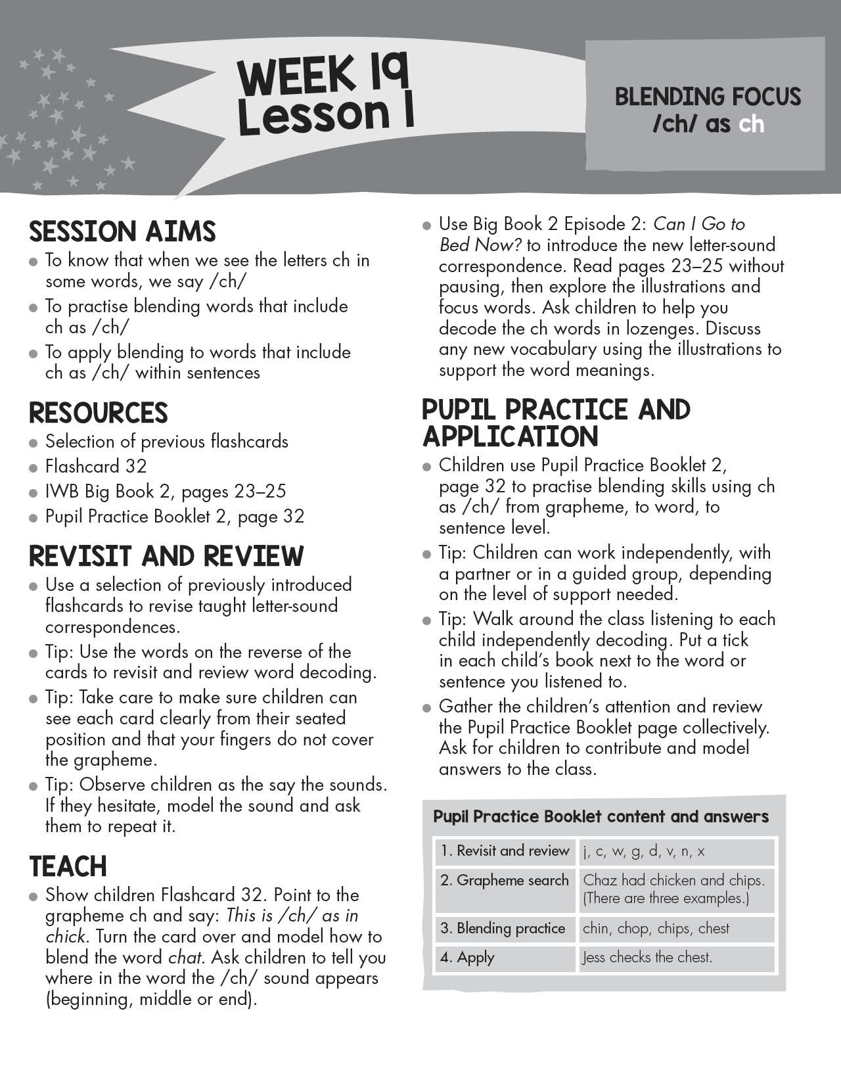
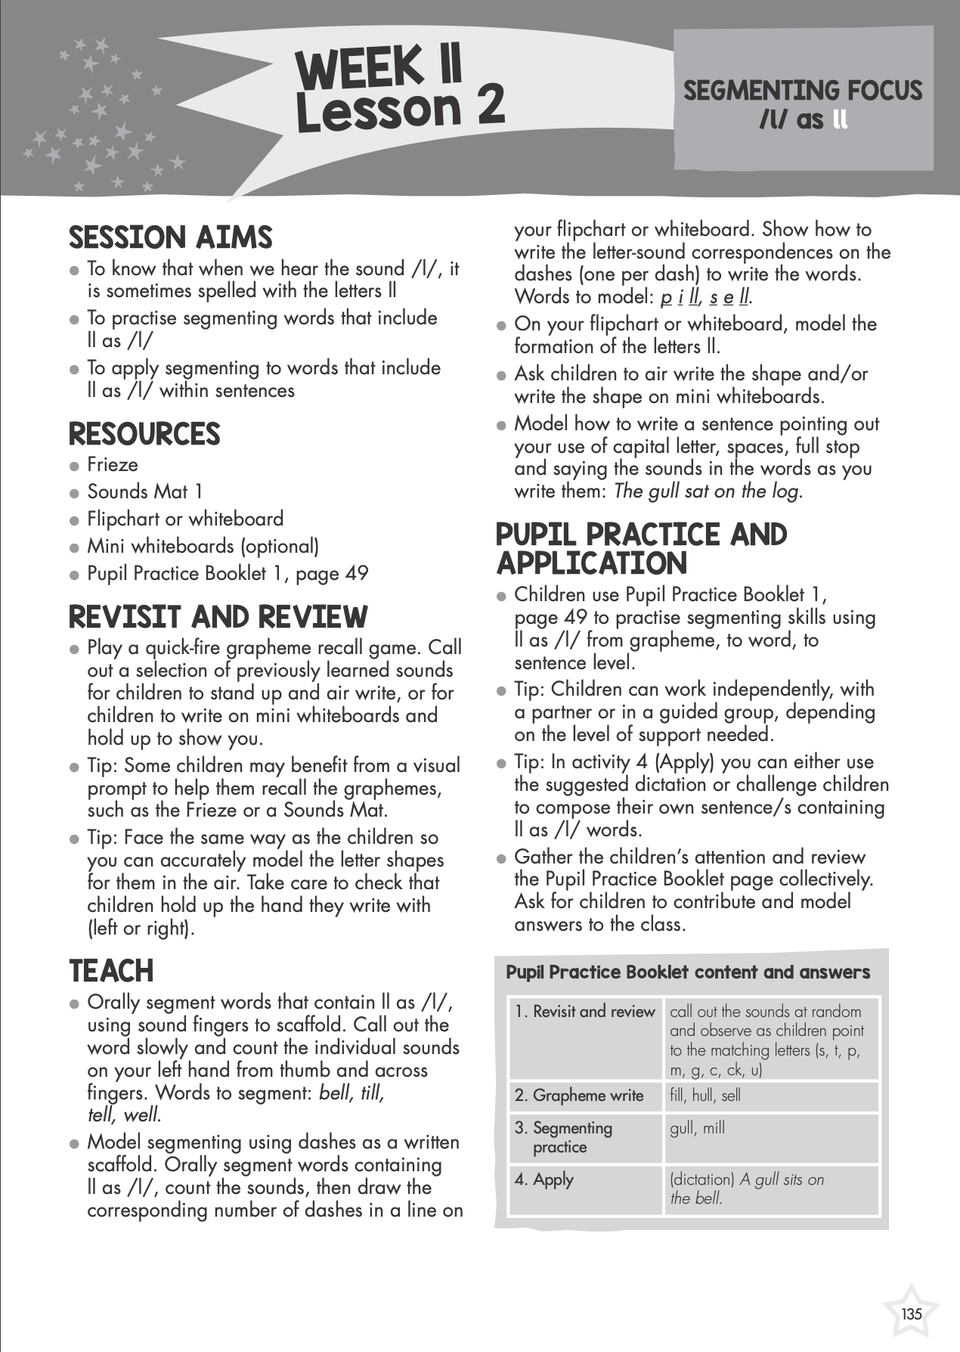
Daily plans
Daily
plans

Slide 52
Inside the lesson
Systematic and incidental
All together, with a partner, individually
Exploration and reinforcement
Little and often opportunities

Slide 53
Outside the lesson
Incidental and planned
Adult and child led
Targeted
Little and often opportunities

Slide 54
Take ownership – success comes from YOU!
Structure to support not control you
Resources to support not control you
Underlying concepts are important
You can make it your own – you will bring it to life!

